Slide 1
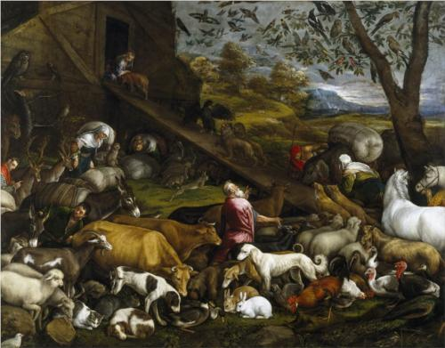
Genesis 6.1-7.24
Jacopo Bassano; wikiart.org

Slide 2
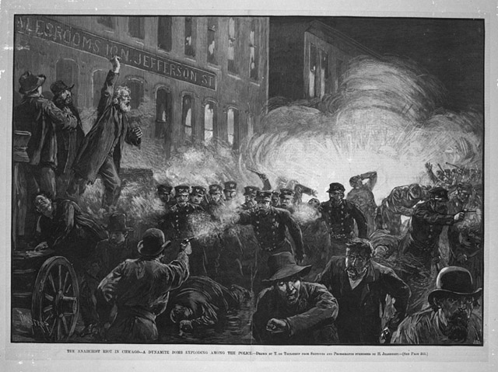
Genesis 6.5 NIV: The LORD saw how great the wickedness of the human race had become on the earth, and that every inclination of the thoughts of the human heart was only evil all the time.
de Thulstrup; Harpers Weekly; ChicagoHistory.org

Slide 3
Genesis 6.11-12 NIV: Now the earth was corrupt in God’s sight and was full of violence. God saw how corrupt the earth had become, for all the people on earth had corrupted their ways.
de Thulstrup; Harpers Weekly; ChicagoHistory.org

Slide 4
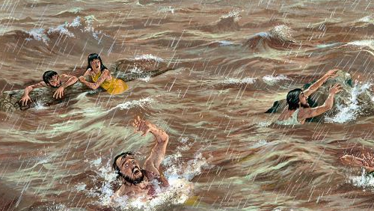
Genesis 6.6 NIV: The LORD regretted that he had made human beings on the earth, and his heart was deeply troubled.
נִחַם = God felt emotional sadness;
God would change his stated plan.

Slide 5
Genesis 6.13 NIV: God said to Noah, “I am going to put an end to all people, for the earth is filled with violence because of them. I am surely going to destroy both them and the earth.”

Slide 6
Genesis 6.13 NIV: God said to Noah, “I am going to put an end to all people, for the earth is filled with violence because of them. I am surely going to destroy both them and the earth.”
Genesis 6.3 NIV: Then the LORD said, “My Spirit will not contend with humans forever, for they are mortal; their days will be a hundred and twenty years.”

Slide 7
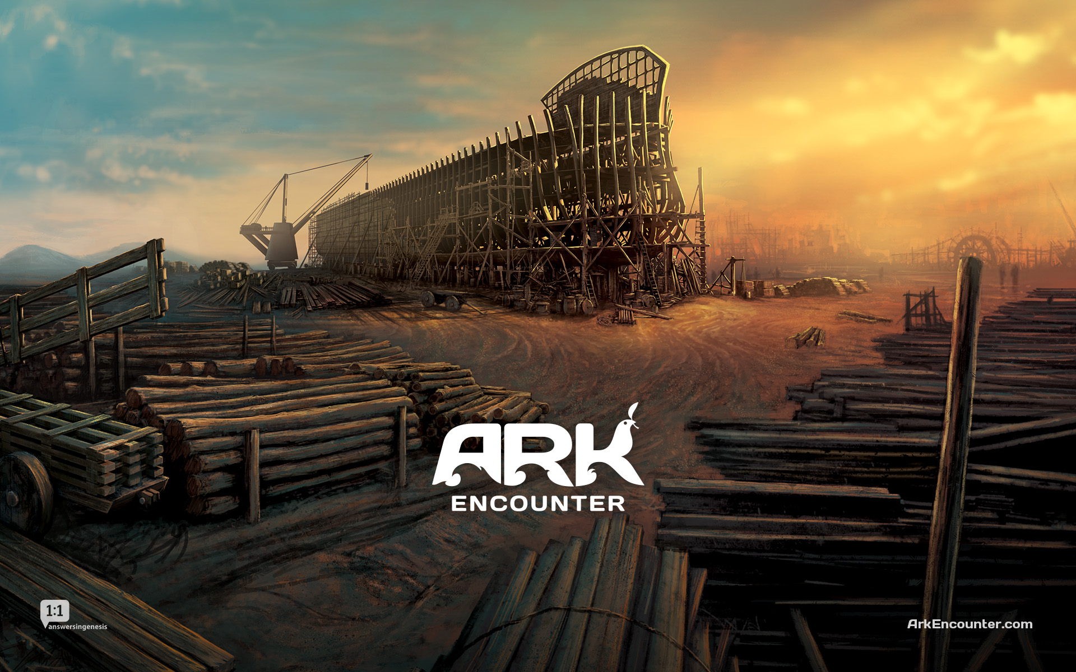
Genesis 6.8 NIV: But Noah found favor in the eyes of the LORD.
חֵן = favor or grace
image from ArkEncounter.com

Slide 8
Genesis 6.8 NIV: But Noah found favor in the eyes of the LORD.
חֵן = favor or grace
Genesis 6.9 [word order]: Noah was a righteous man; he was blameless among his contemporaries. With God walked Noah.
image from ArkEncounter.com

Slide 9
Hebrews 11.6-7 NET: Now without faith it is impossible to please him, for the one who approaches God must believe that he exists and that he rewards those who seek him. By faith Noah, when he was warned about things not yet seen, with reverent regard constructed an ark for the deliverance of his family. Through faith he condemned the world and became an heir of the righteousness that comes by faith.

Slide 10
Genesis 7.23 NASB: … only Noah was left, together with those that were with him in the ark.
niphal form of שָׁאַר
image from ArkEncounter.com

Slide 11
Genesis 6.18 NIV: “I will establish my covenant with you, and you will enter the ark—you and your sons and your wife and your sons’ wives with you.”
hiphil form of קוּם = keep or fulfill
Jacopo Bassano; wikiart.org

Slide 12
Psalm 14.1-3 NIV: The fool says in his heart, ‘There is no God.’ They are corrupt, their deeds are vile; there is no one who does good. The LORD looks down from heaven on all mankind to see if there are any who understand, any who seek God. All have turned away, all have become corrupt; there is no one who does good, not even one.
Jacopo Bassano; wikiart.org

Slide 13
Matthew 24.37-39 NET: “For just like the days of Noah were, so the coming of the Son of Man will be. For in those days before the flood, people were eating and drinking, marrying and giving in marriage, until the day Noah entered the ark. And they knew nothing until the flood came and took them all away. It will be the same at the coming of the Son of Man.”
Jacopo Bassano; wikiart.org

Slide 14
Study materials available at www.groben.com
Genesis 6.1-7.24
Jacopo Bassano; wikiart.org

